Slide 1
Overview of DBMS
BCAN - 401

Slide 2
What do you mean by Data?
Data is a collection of facts and figures that can be processed to produce information.
What do you mean by Database?
Database is a collection of co-related data which is used to retrieve, insert and delete the data efficiently. It is also used to organize the data in the form of a table, schema, views and reports etc.
What do you mean by DBMS?
A database management system stores data in such a way that it becomes easier to retrieve, manipulate and produce information.
State the goals of DBMS?
The goal of a DBMS is to provide an environment, that is both convenient and efficient to use in –
Retrieving information from the database
Storing information into the database

Slide 3
Some Specific Definitions –
Data Definition – It is used for creation, modification and removal of definitions that defines the organization of data in the database.
Data Updation – It is used for insertion, modification and deletion of the actual data in the database.
Data Retrieval – It is used to retrieve the data from the database which can be used by applications for various purpose.
Advantages –
Controls database redundancy
Data Sharing
Easily Maintenance
Reduce Time
Back up and Recovery
Multiple User Interface

Slide 4
Dis – advantages –
Cost of hardware & software
Size
Complexity
Higher impact of failure
Characteristics of DBMS -
It uses a digital repository established on a server to store and manage the information.
It can provide a clear and logical view of the process that manipulates data.
DBMS contains automatic backup and recovery procedures.
It contains ACID properties which maintain data in a healthy state in case of failure.
It can reduce the complex relationship between data.
It is used to support manipulation and processing of data.
It is used to provide security of data.
It can view the database from different viewpoints according to the requirements of the user.

Slide 5
What are the differences between File System and DBMS?
DBMS | File System
DBMS is a collection of data. In DBMS, the user is not required to write the procedures. | File system is a collection of data. In this system, the user has to write the procedures for managing the database.
DBMS gives an abstract view of data that hides the details. | File system provides the detail of the data representation and storage of data.
DBMS provides a crash recovery mechanism, i.e., DBMS protects the user from the system failure. | File system doesn't have a crash mechanism, i.e., if the system crashes while entering some data, then the content of the file will lost.
DBMS provides a good protection mechanism. | It is very difficult to protect a file under the file system.
DBMS contains a wide variety of sophisticated techniques to store and retrieve the data. | File system can't efficiently store and retrieve the data.
DBMS takes care of Concurrent access of data using some form of locking. | In the File system, concurrent access has many problems like redirecting the file while other deleting some information or updating some information.

Slide 6
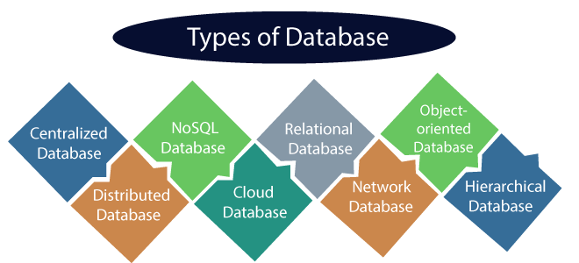
What are the different types of database?

Slide 7
What do you mean by Centralized Database?
It is the type of database that stores data at a centralized database system. It comforts the users to access the stored data from different locations through several applications. These applications contain the authentication process to let users access data securely.
For example – Centralized Library of a College/University
Advantages –
It has decreased the risk of data management, i.e., manipulation of data will not affect the core data.
Data consistency is maintained as it manages data in a central repository.
It provides better data quality, which enables organizations to establish data standards.
It is less costly because fewer vendors are required to handle the data sets.
Dis-advantages -
The size of the centralized database is large, which increases the response time for fetching the data.
It is not easy to update such an extensive database system.
If any server failure occurs, entire data will be lost, which could be a huge loss

Slide 8
What do you mean by Distributed Database?
Unlike a centralized database system, in distributed systems, data is distributed among different database systems of an organization. These database systems are connected via communication links. Such links help the end-users to access the data easily.
For example – Apache Cassandra, Hbase, Ignite etc.
Homogeneous DDB: Those database systems which execute on the same operating system and use the same application process and carry the same hardware devices.
Heterogeneous DDB: Those database systems which execute on different operating systems under different application procedures, and carries different hardware devices.
Advantages –
Modular development is possible in a distributed database, i.e., the system can be expanded by including new computers and connecting them to the distributed system.
One server failure will not affect the entire data set.

Slide 9
What do you mean by Relational Database?
This database is based on the relational data model, which stores data in the form of rows (tuple) and columns (attributes), and together forms a table(relation). A relational database uses SQL for storing, manipulating, as well as maintaining the data. E.F. Codd invented the database in 1970. Each table in the database carries a key that makes the data unique from others.
For example – Oracle, MySql, Microsoft SQL Server etc.
Properties – There are following four commonly known properties of a relational model known as ACID properties, where -
A means Atomicity: This ensures the data operation will complete either with success or with failure. It follows the 'all or nothing' strategy.
C means Consistency: If we perform any operation over the data, its value before and after the operation should be preserved.
I means Isolation: There can be concurrent users for accessing data at the same time from the database. Thus, isolation between the data should remain isolated.
D means Durability: It ensures that once it completes the operation and commits the data, data changes should remain permanent.

Slide 10
What do you mean by NoSQL Database?
Non-SQL/Not Only SQL is a type of database that is used for storing a wide range of data sets. It is not a relational database as it stores data not only in tabular form but in several different ways. It came into existence when the demand for building modern applications increased. Thus, NoSQL presented a wide variety of database technologies in response to the demands.
For example – SQLite
There are four types of NoSQL –
Key-value storage: It is the simplest type of database storage where it stores every single item as a key (or attribute name) holding its value, together.
Document-oriented Database: A type of database used to store data as JSON-like document. It helps developers in storing data by using the same document-model format as used in the application code.
Graph Databases: It is used for storing vast amounts of data in a graph-like structure. Most commonly, social networking websites use the graph database.
Wide-column stores: It is similar to the data represented in relational databases. Here, data is stored in large columns together, instead of storing in rows.

Slide 11
Advantages –
It enables good productivity in the application development as it is not required to store data in a structured format.
It is a better option for managing and handling large data sets.
It provides high scalability.
Users can quickly access data from the database through key-value.
Cloud Database –
A type of database where data is stored in a virtual environment and executes over the cloud computing platform. It provides users with various cloud computing services (SaaS, PaaS, IaaS, etc.) for accessing the database.
There are numerous cloud platforms, but the best options are -
Amazon Web Services (AWS)
Microsoft Azure
Kamatera
PhonixNAP
ScienceSoft
Google Cloud SQL
etc.

Slide 12
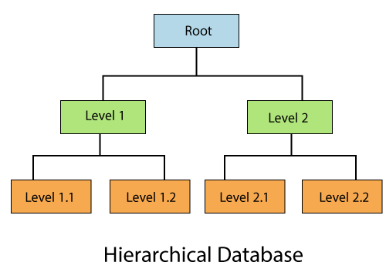
Object Oriented Database –
The type of database that uses the object-based data model approach for storing data in the database system. The data is represented and stored as objects which are similar to the objects used in the object-oriented programming language.
Hierarchical Database –
It is the type of database that stores data in the form of parent-children relationship nodes. Here, it organizes data in a tree-like structure.

Slide 13
Network Database –
It is the database that typically follows the network data model. Here, the representation of data is in the form of nodes connected via links between them. Unlike the hierarchical database, it allows each record to have multiple children and parent nodes to form a generalized graph structure.
Personal Database –
Collecting and storing data on the user's system defines a Personal Database. This database is basically designed for a single user.
Advantages –
It is simple and easy to handle.
It occupies less storage space as it is small in size.
Operational Database –
The type of database which creates and updates the database in real-time. It is basically designed for executing and handling the daily data operations in several businesses. For example, An organization uses operational databases for managing per day transactions.

Slide 14
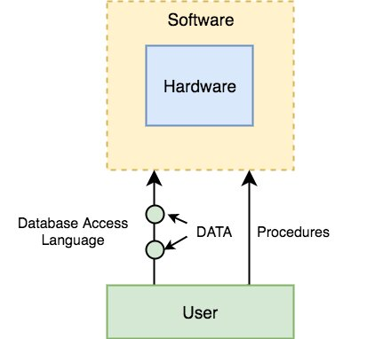
Enterprise Database –
Large organizations or enterprises use this database for managing a massive amount of data. It helps organizations to increase and improve their efficiency. Such a database allows simultaneous access to users.
Advantages –
Multi processes are supportable over the Enterprise database.
It allows executing parallel queries on the system.
Components of DBMS –
The DBMS can be divided into five major components, they are –
Hardware
Software
Data
Procedures
Data Access Language (SQL)

Slide 15
DBMS Components: Data
Data is that resource, for which DBMS was designed. The motive behind the creation of DBMS was to store and utilize data.
In a typical Database, the user saved Data is present and meta data is stored.
Metadata is data about the data. This is information stored by the DBMS to better understand the data stored in it.
For example: When I store my Name in a database, the DBMS will store when the name was stored in the database, what is the size of the name, is it stored as related data to some other data, or is it independent, all this information is metadata.

Slide 16
Database Users
Database Administrators: Database Administrator or DBA is the one who manages the complete database management system. DBA takes care of the security of the DBMS, it's availability, managing the license keys, managing user accounts and access etc.
Application Programmer or Software Developer: This user group is involved in developing and designing the parts of DBMS.
End User: These days all the modern applications, web or mobile, store user data. How do you think they do it? Yes, applications are programmed in such a way that they collect user data and store the data on DBMS systems running on their server. End users are the one who store, retrieve, update and delete data.

Slide 17
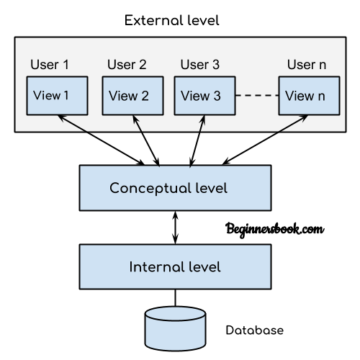
DBMS – Three Level Architecture

Slide 18
This architecture has three levels: 1. External level 2. Conceptual level 3. Internal level
External level –
It is also called view level. The reason this level is called “view” is because several users can view their desired data from this level which is internally fetched from database with the help of conceptual and internal level mapping.
External level is the “top level” of the Three Level DBMS Architecture.

Slide 19
Conceptual level
It is also called logical level. The whole design of the database such as relationship among data, schema of data etc. are described in this level.
Database constraints and security are also implemented in this level of architecture. This level is maintained by DBA (database administrator).
Internal level
This level is also known as physical level. This level describes how the data is actually stored in the storage devices. This level is also responsible for allocating space to the data. This is the lowest level of the architecture.

Slide 20
Data Dictionary –
Data Dictionary can be defined as collection of information of all data elements or contents of databases such as data types, text descriptions of system. It makes it easier for user and analyst to use data as well as understand and have common knowledge about inputs, outputs, components of a database, and intermediate calculations.
Why Data dictionary is essential ?
There are less information and details provided by data models. So, a data dictionary is very essential and needed to have proper knowledge and usage of contents.
Data Dictionary provides all information about names that are used in system models.
Data Dictionary also provides information about entities, relationships, and attributes that are present in system model.
As a part of structured analysis and design tool, implementation of a data dictionary is done.

